Slide 1

12 FACTor app METHODOLOGIES

Slide 2
WHAT IS 12 factor app
The Twelve-Factor App methodology is a methodology for building software-as-a-service applications
These are best practices designed to enable applications to be built with portability and resilience when deployed to the web..

Slide 3
GOAL of 12 factor app
Minimize the effort of getting a new developer set up.
Minimize dependencies on the underlying platform running the application.
Maximize the portability of the applications between different runtime environments
Focuses on environment parity between dev and prod.
Make deploying our application to modern cloud platforms easy.

Slide 4
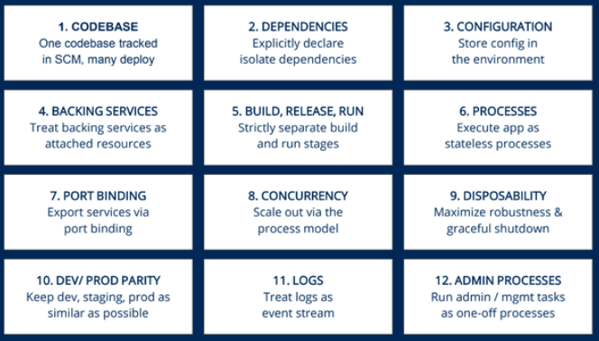
12 factor app principles

Slide 5
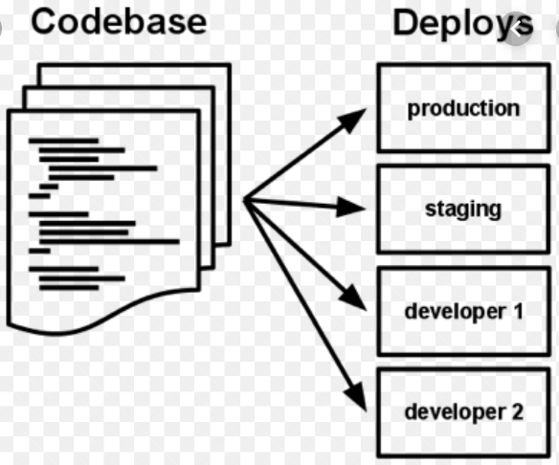
CODEBASE
“One codebase tracked in revision control, many deploys”
The code base should have a logical version control system that’s easy to understand.
Every deployment should have its own code repository that can be deployed to multiple environments.
Avoid housing multiple applications in the same repository.
Example: USE SVN or GITHUB for handling revision control of our applications

Slide 6
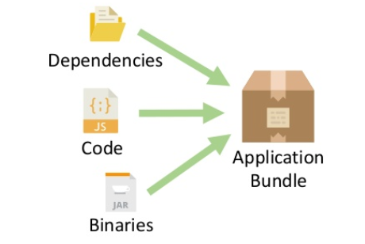
Dependencies
“Explicitly declare and isolate dependencies”
This principle maintains that you should never rely on the implicit existence of system-wide packages.
The application should be isolated sufficiently to avoid interactions with conflicting libraries that are installed on the host machine.
Example: In Angular we can achieve declaration and isolation by using npm. In Spring Boot it can be done using pom.xml

Slide 7
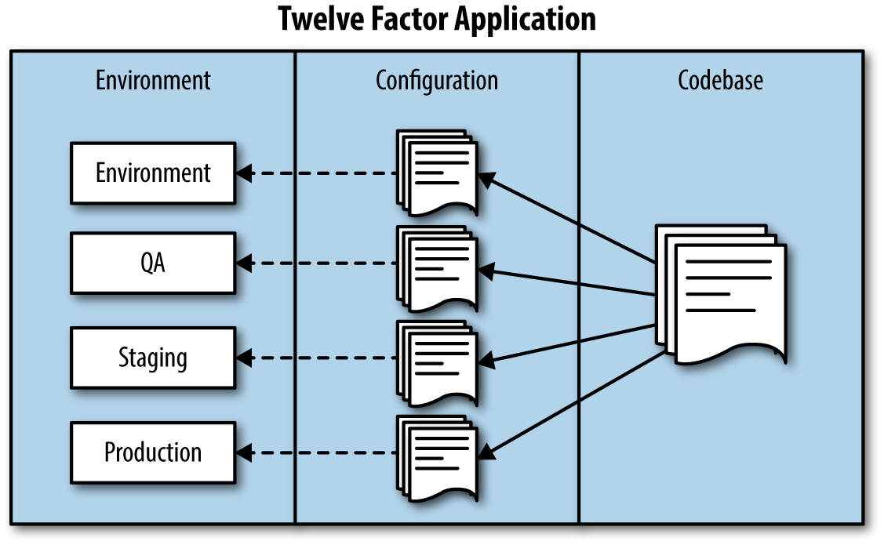
Config
“Store config in the environment”
An application and its configuration should be completely independent.
Storing configs constantly in code should be avoided entirely.
Our configurations should have a separate file and shouldn’t be hosted within the code repository.
Example: In SPRING BOOT there is a separate file(app.properties) to handle configuration.

Slide 8
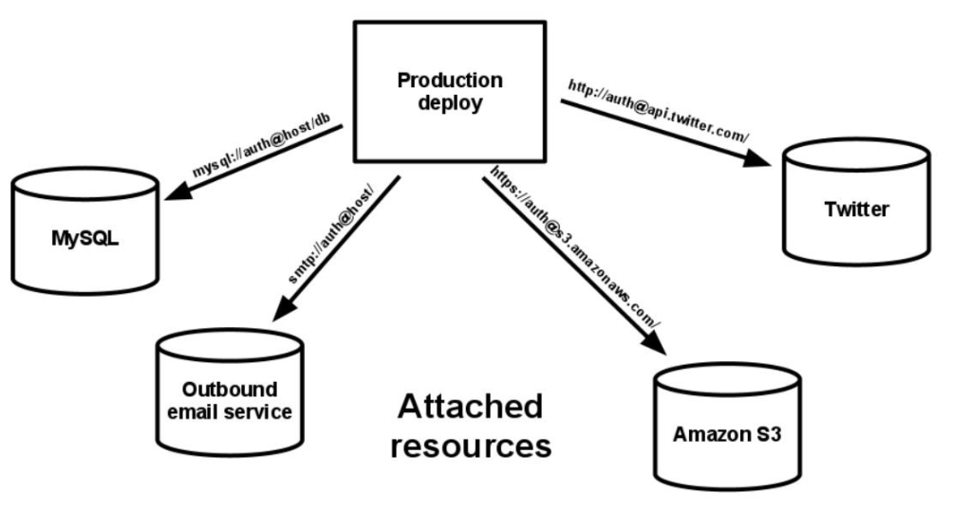
Backing services
“Treat backing services as attached resources”
A backing service such as an MySQL DB should be able to be swapped out without any changes to the code
These should be accessed as a service via HTTP or similar request, then specified in the config.
Example: Angular and spring boot connectivity using rest api’s.

Slide 9
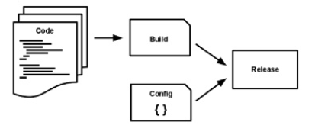
Build, release, run
“Strictly separate build and run stages”
A Start the build process by storing the app in source control, then build out its dependences.
Separating the config information means you can combine it with the build for the release stage—and then it’s ready for the run stage.
Example: In Angular we initially do a build to get minified javascript files and later run it

Slide 10
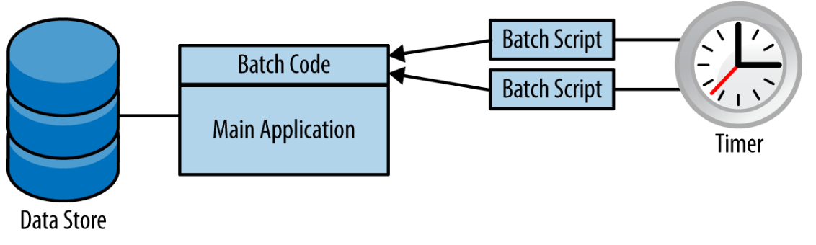
PROCESSES
“Execute the app as one or more stateless processes”
Store any data that is required to persist in a stateful backing service, such as databases.
The idea is that the process is stateless and shares absolutely nothing..

Slide 11
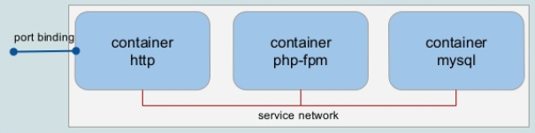
Port binding Principle
“Export services via port binding”
twelve-factor app is completely self-contained and does not require runtime injection of a web server into the execution environment.
The application should expose HTTP as a service and bind to that port to expose its services on.
Example: Spring Boot has embedded web server and we can just expose the port to bind http requests.

Slide 12
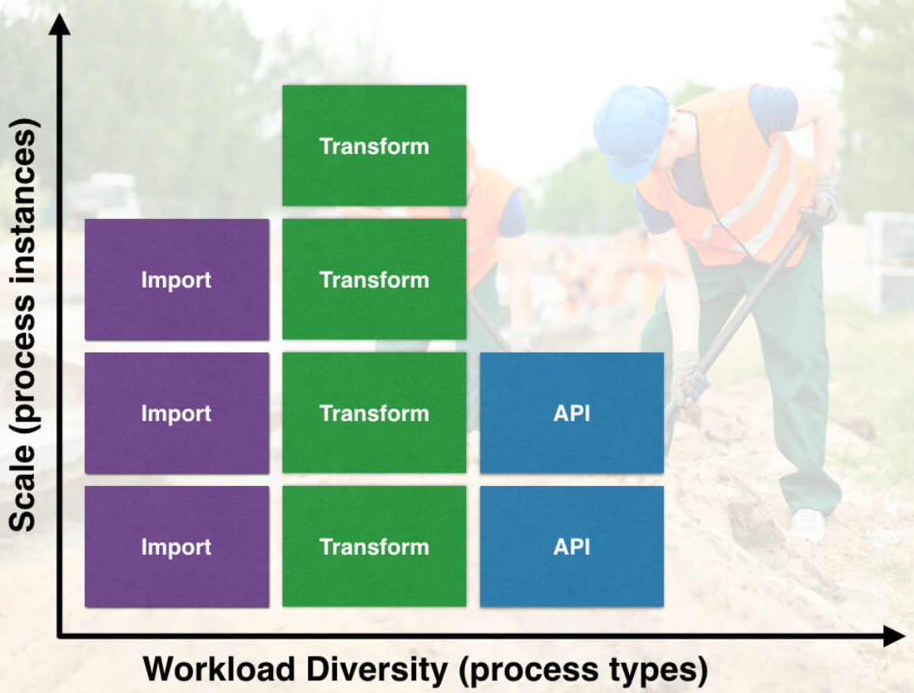
CONCURRENCY
“Scale out via the process model”
The application must run only one process on the os.
Our app must be able to add more instances instead of more memory on the CPU.

Slide 13
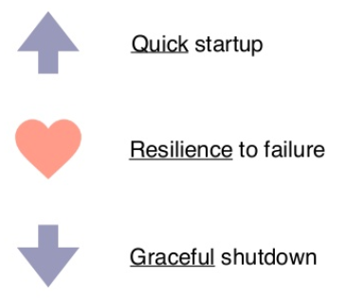
DISPOSABILITY
“Maximize robustness with fast startup and graceful shutdown”
The concept of disposable processes means that an application can die at any time, but it won’t affect the user—the app can be replaced by other apps, or it can start right up again.
Building disposability into your app ensures that the app shuts down gracefully: it should clean up all utilized resources and shut down smoothly.
Example:- amazon payment app. If internet connectivity is disrupted in half way of payment process, the payment process will still get completed.

Slide 14
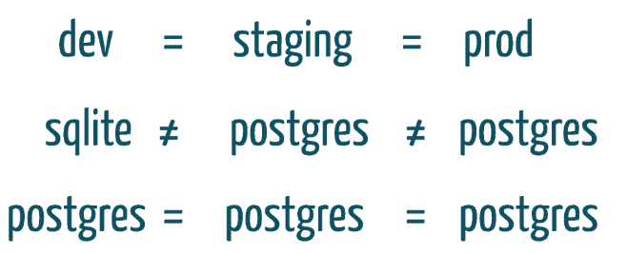
Dev/prod parity
“Keep development, staging, and production as similar as possible”
Applications deployed to development and production should have parity.
there should be only the slightest difference between both deployments.
A vast difference may lead to unintended compatibility issues between dev and production code.

Slide 15
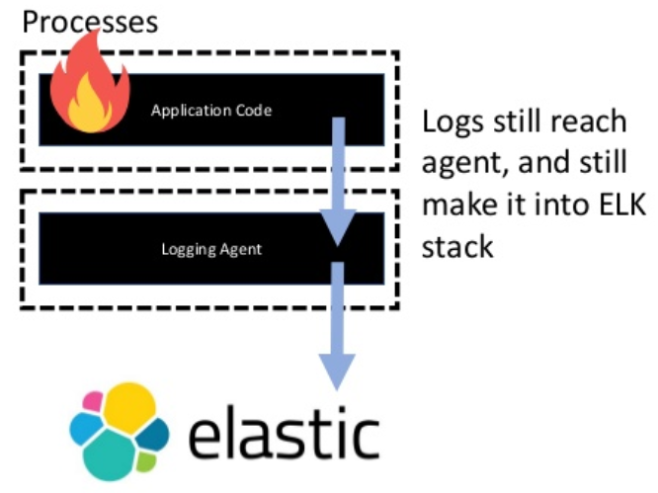
LOGS
“Treat logs as event streams”
nlike monolithic and traditional apps that store log information in a file, this principle maintains that you should stream logs to a chosen location—not simply dump them into a log file.
Typically, logs don’t reside in the same place within cloud-based environments after every burn.
As new processes start or your app crashes, the logs will be distributed across several cloud machines.

Slide 16
ADMIN PROCESSES
“Run admin/management tasks as one-off processes”
The final 12-factor app principle proposes separating administrative tasks from the rest of your application.
These tasks might include migrating a database or inspecting records.
Though the admin processes are separate, you must continue to run them in the same environment and against the base code and config of the app itself.
EXAMPLE: In an angular application the end user screens of admin and user should be different. This can be done by just changing the views based on conditions

Slide 17

THANK YOU!!!

